Slide 1
AP Final project
By : Ali Motallebi , Dorsa Nazari, Maryam Barazande

Slide 2
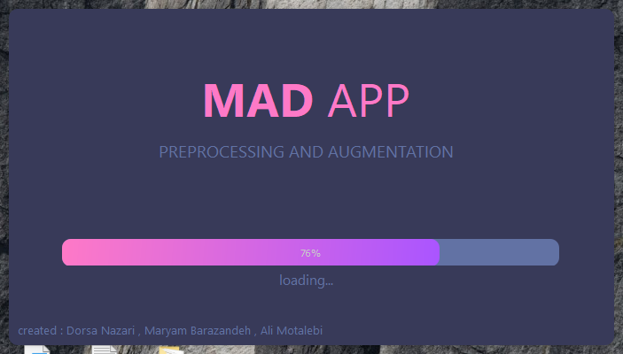
preview

Slide 3
menu
Upload your images
You can do:
add labels and tags
Resize your images
Flip horizontal or vertical
Crop your image
Rotate your image
Change brightness
Add noise
Blur it
Add a filter
Finally split it to train and test data
Or
You can use fast mode

Slide 4
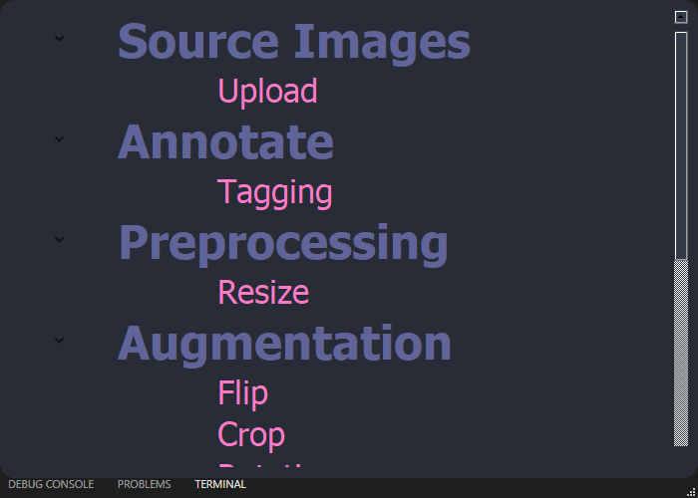
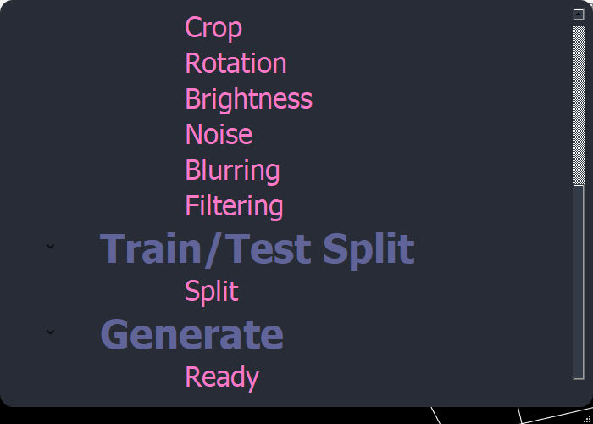
You can see all of it by scroll down

Slide 5
abilities
Ammotate –> Tagging
Add label to part of image that you want
Preprocessing ->Resize
resize image to every size you want
Augmentation -> Flip
Flip images horizontally or vertically or both
Augmentation -> crop
Crop a piece of image and save it as another image

Slide 6
abilities
Augmentation -> rotation
Rotate image by an edit slider in any degree
Augmentation -> brightness
Increase or decrease brightness of image with a slider
Augmentation -> noise
Add 6 type of noise such as Gaussian, speckle , poisson, salt, s&p , pepper to image in any range you want
Augmentation -> blurring
Blur image in gaussian , median , bilaterial style

Slide 7
abilities
Augmentation -> filtering
Add number of filters such as invert, sepia, denoised,… to image
Train/Test Split
Divide your data into train and test data in any percentage you need
Fast mode -> fast augmentation
You can choose the items you want to change and apply it with just one click
upload
Browse and Upload any number of data set of images you want

Slide 8
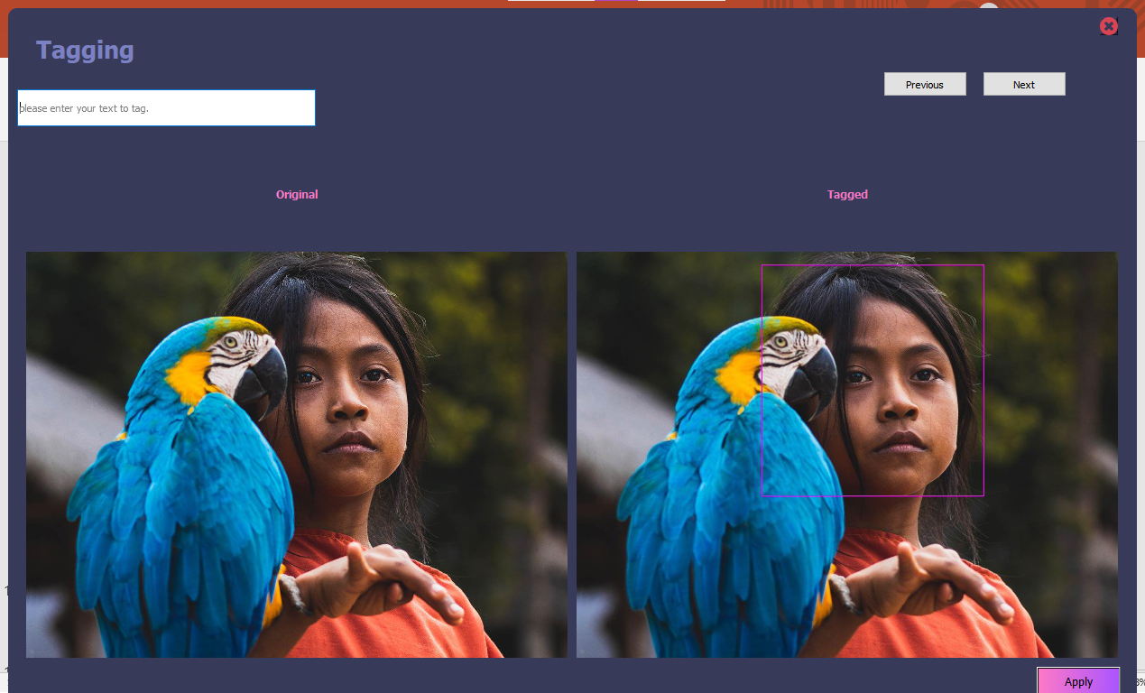
Lets take a look to app!
EASY TO USE
No limits
User friendly
Here you can tag a part of image like face!
You can apply it to all faces in your data set and make a collection by a special tag

Slide 9
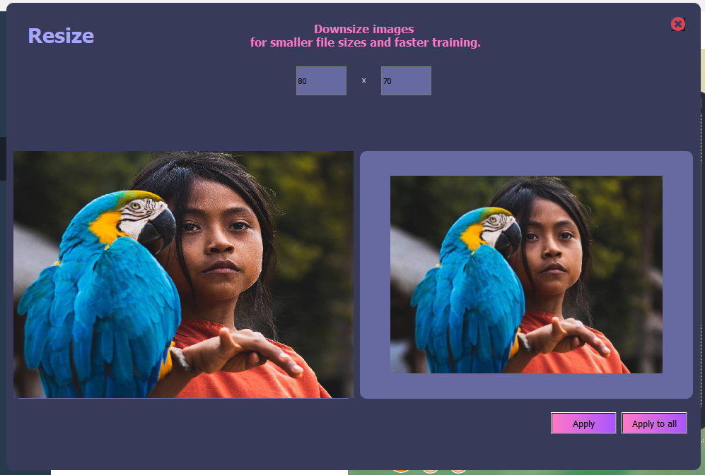
USEFUL
TESTED
Diverse abilities

Slide 10
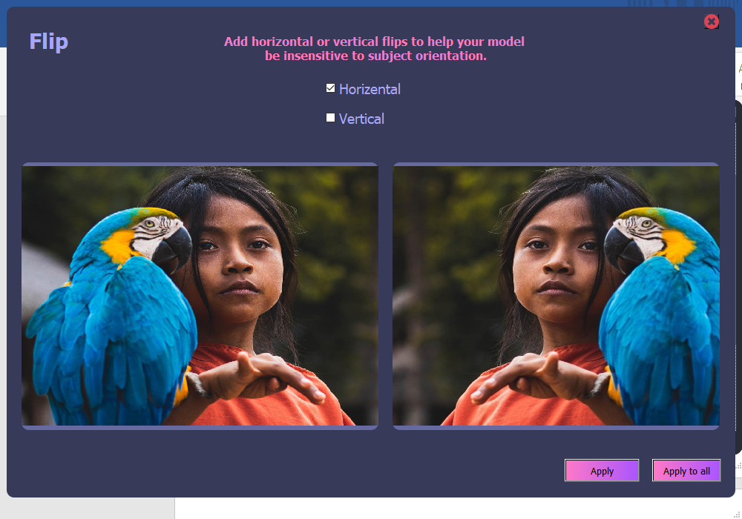
Beautiful ready to use fast
Cool and stylish product
Areas for community connections
Online store and market swap

Slide 11
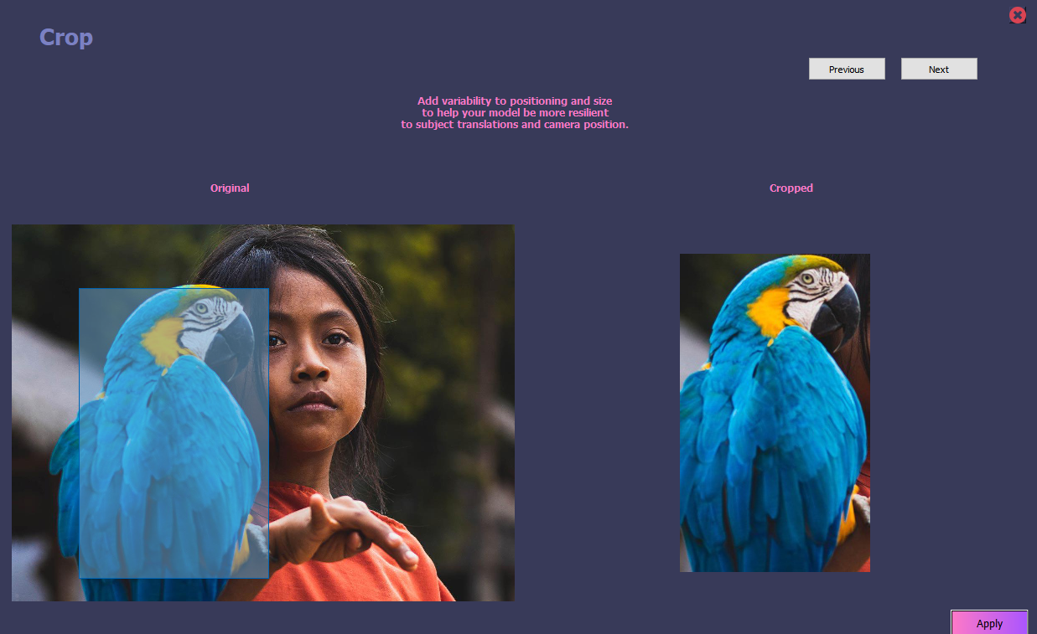
COMPANY OVERVIEW
Crop by just a click!

Slide 12
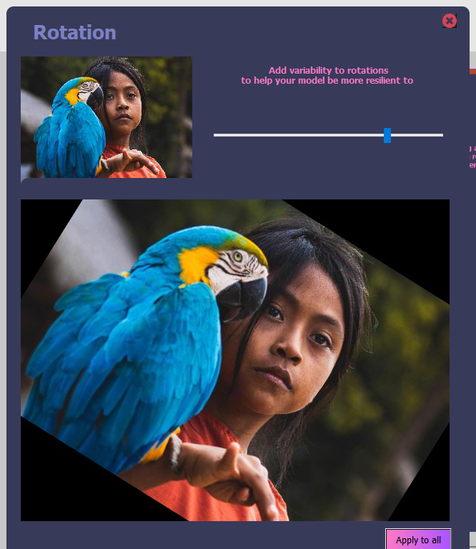
Rotate easily
ABSTRACT
We based our research on market trends and social media
DESIGN
We believe people need more products specifically dedicated to this niche market
RESEARCH
Minimalist and easy to use

Slide 13
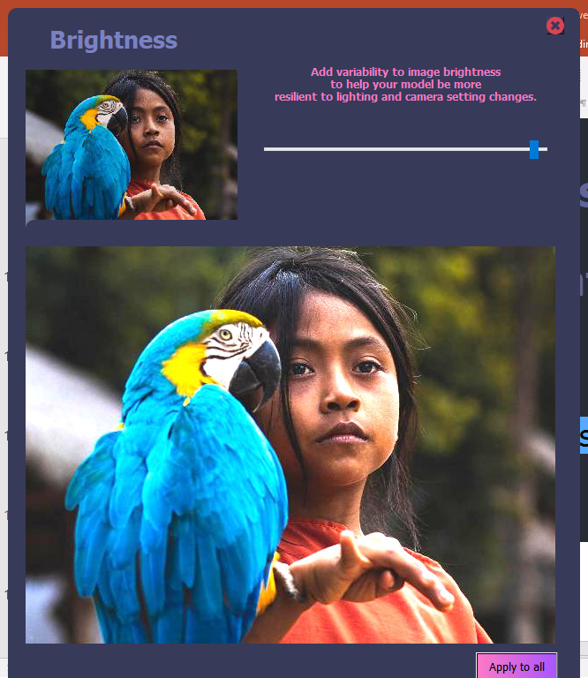
Make your image darker or brighter to have strong data set!
$2 Billion
Few competitors
Specifically targeted market
Serviceable obtainable market

Slide 14
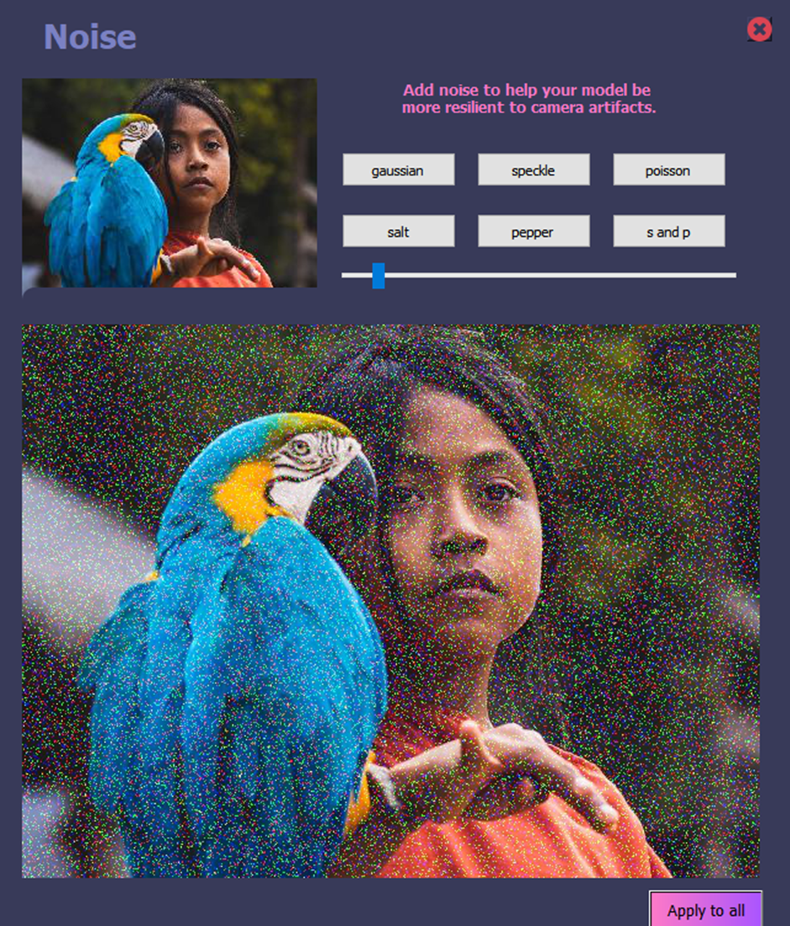
Various noise you can add in any intensity

Slide 15
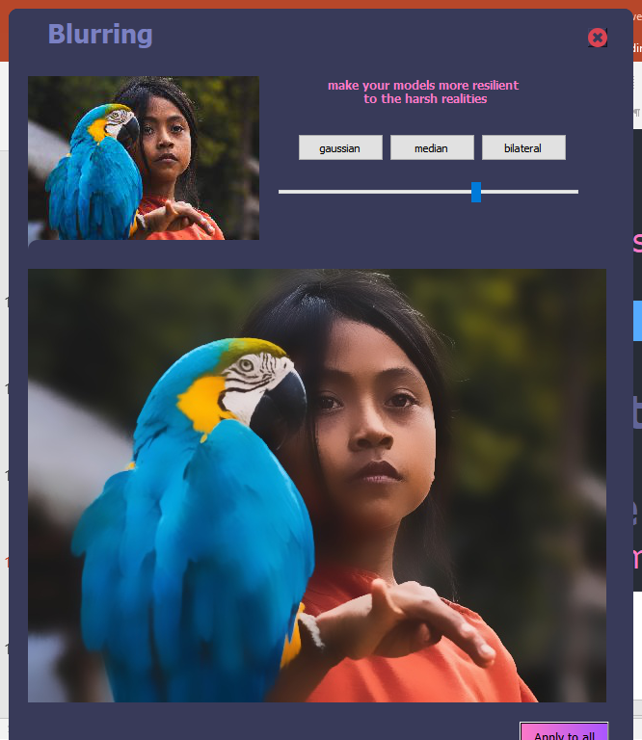
Have blur image in three style

Slide 16
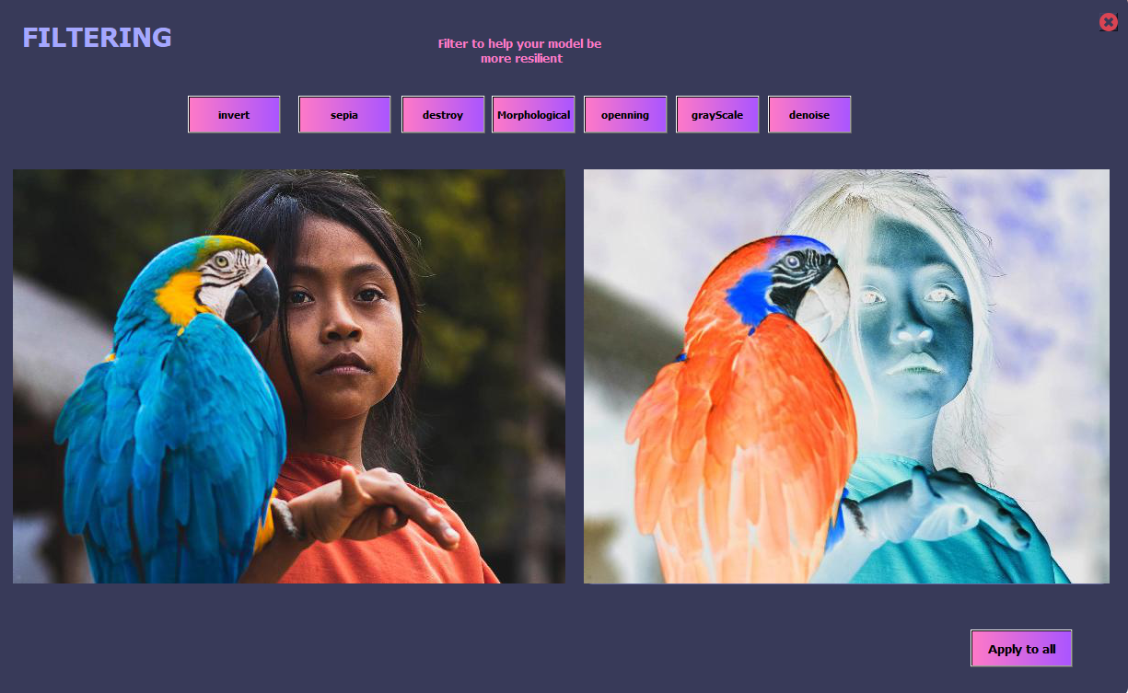
Apply filter in special cases

Slide 17
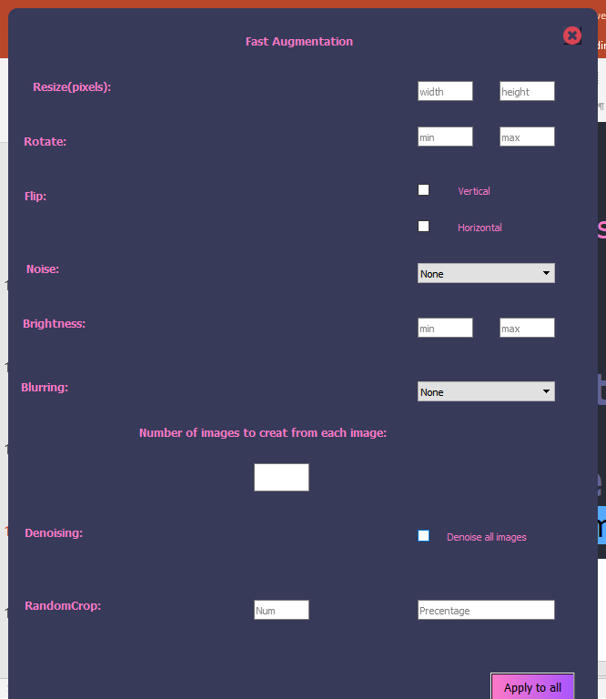
Fast augmentation
Apply all augmentation in a single window and one click to have double data with this parameters!

Slide 18
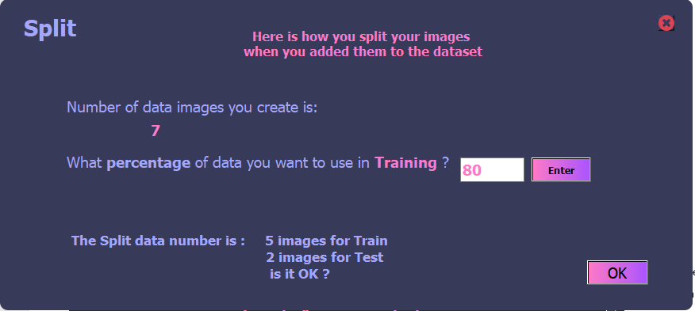
SPLIT TO TRAIN\TEST
In any data set you need some data for train and some for test. All you have to do is enter the percentage of it ang get split data in two different folder randomly !

Slide 19
THANKs for watching

